Slide 1
COVID-19 Clinical Trials EDA Pandas

Slide 2
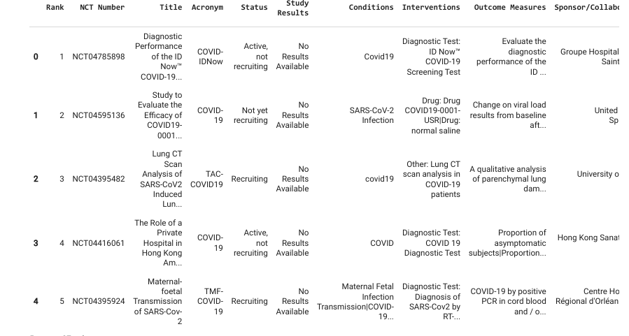
Exploring Data Set

Slide 3
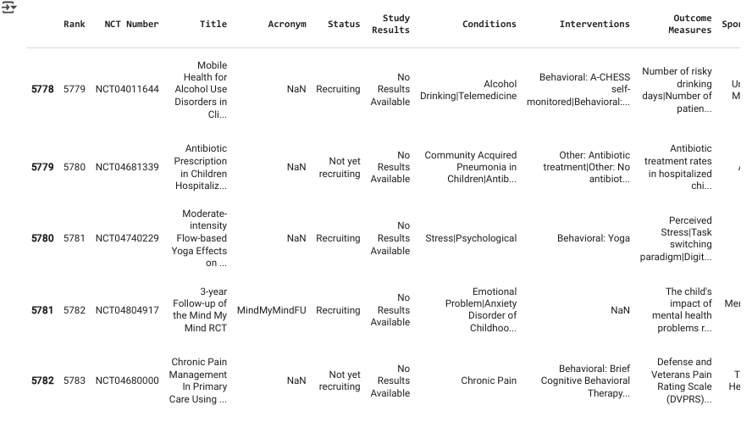

Slide 4
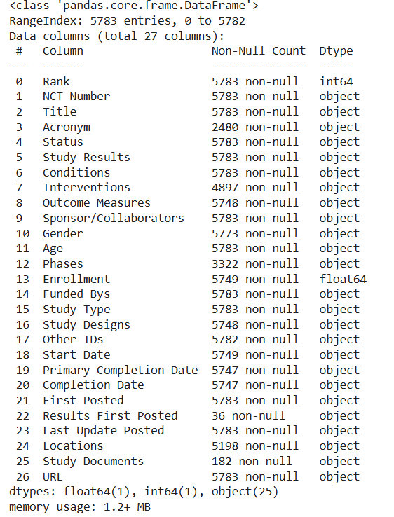
Info Of the Data

Slide 5
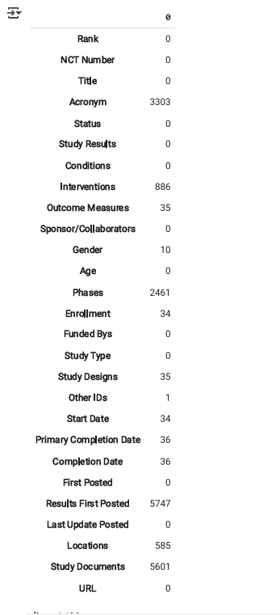
Data cleaning

Slide 6
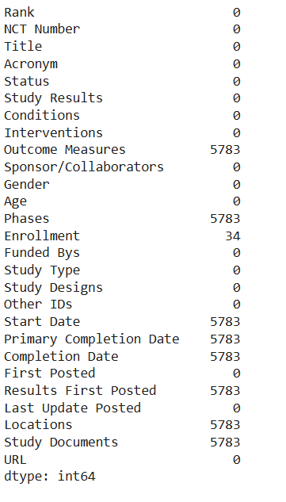
Missing Values

Slide 7
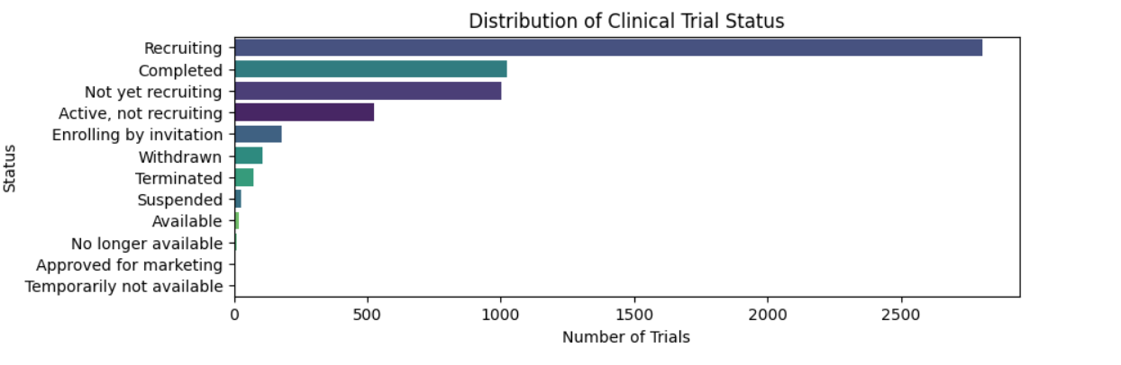
Distribution of Clinical Trails

Slide 8
Summary: The bar chart illustrates the distribution of clinical trials across various statuses. This helps to understand the current landscape of ongoing and past clinical trials.
Key Observations:
Recruiting: The highest number of trials fall under this category, with the bar extending beyond 2500 trials. This indicates that a significant number of clinical trials are actively seeking participants.
Completed: This status has the second-highest number of trials, approximately around 1000 trials. These trials have concluded and have gathered the necessary data.
Not yet recruiting: The trials that haven't started recruiting yet also hold a notable count.
Active, not recruiting: Trials that are ongoing but not accepting new participants.
Enrolling by invitation: These trials are selectively recruiting participants by invitation only.
Withdrawn, Terminated, and Suspended: These categories have fewer trials. "Withdrawn" trials are those that were halted before enrollment began, while "Terminated" trials were stopped after they had started, and "Suspended" trials are temporarily paused.
Other Categories: "Available," "No longer available," "Approved for marketing," and "Temporarily not available" have the least number of trials.

Slide 9
Visual Representation: The chart provides a clear visual representation of the trial statuses, with horizontal bars indicating the number of trials in each status. This can aid in identifying which stages of clinical trials are most common and which are less frequent.
Implications:
The high number of recruiting trials suggests a dynamic and active landscape in clinical research, indicating ongoing efforts to explore new treatments and interventions.
The completed trials provide a wealth of data and findings that can contribute to scientific advancements and clinical practices.

Slide 10
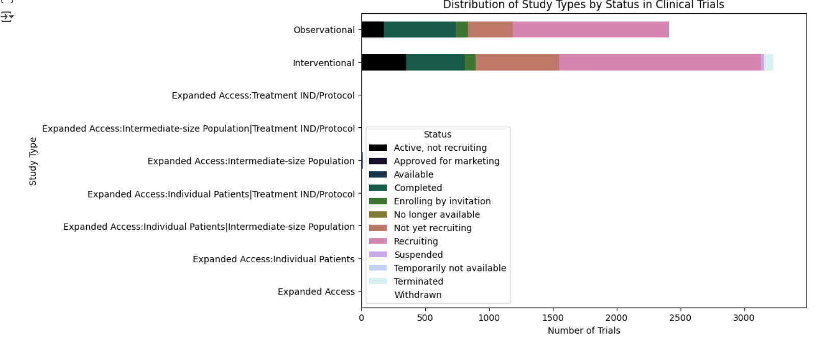

Slide 11
The image you provided presents a bar chart titled "Distribution of Study Types by Status in Clinical Trials." It categorizes different types of clinical studies and their statuses. Here's a detailed analysis:
Study Types:
Observational
Interventional
Expanded Access: Treatment IND/Protocol
Expanded Access: Intermediate-size Population|Treatment IND/Protocol
Expanded Access: Intermediate-size Population
Expanded Access: Individual Patients|Treatment IND/Protocol
Expanded Access: Individual Patients|Intermediate-size Population
Expanded Access: Individual Patients
Expanded Access

Slide 12
Statuses:
Active, not recruiting
Approved for marketing
Available
Completed
Enrolling by invitation
No longer available
Not yet recruiting
Recruiting
Suspended
Temporarily not available
Terminated
Withdrawn

Slide 13
Key Observations:
Interventional and Observational Studies: These are the most common types of studies, with the majority being in the "Recruiting" status. This indicates a high level of ongoing clinical trials actively seeking participants.
Completed Studies: There are a significant number of completed trials, particularly in the interventional category. This provides valuable data for future research and clinical practice.
Expanded Access Categories: These categories have fewer trials, reflecting specialized access to treatments, often involving smaller or more specific populations.
Other Statuses: Categories such as "Active, not recruiting," "Enrolling by invitation," and "Not yet recruiting" also have a notable number of trials, showcasing the various stages and accessibility of clinical studies.

Slide 14
Visual Representation:
The chart uses color-coded bars to represent different statuses, making it easy to visualize and compare the distribution across study types. The x-axis shows the number of trials (ranging from 0 to 3000), while the y-axis lists the study types.
This chart provides a comprehensive overview of the current landscape of clinical trials, highlighting the diversity and status of ongoing research efforts.

Slide 15
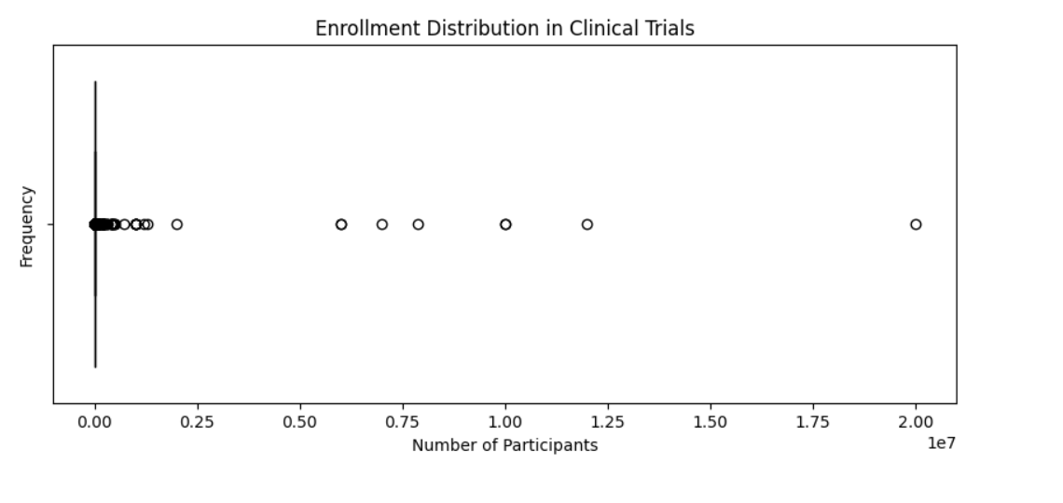

Slide 16
Summary
The scatter plot titled "Enrollment Distribution in Clinical Trials" provides a visual representation of the number of participants in various clinical trials. The x-axis shows the Number of Participants ranging from 0 to 2.0 x 10^7, and the y-axis represents Frequency.
Key Observations
Clustered Data Points: The majority of the clinical trials have a small number of participants. This is evident from the high frequency of data points near the lower end of the x-axis.
Outliers: There are a few trials with significantly higher enrollment numbers, spread along the x-axis. These outliers indicate trials that have managed to enroll a large number of participants compared to the average.

Slide 17
Analysis
The plot reveals that most clinical trials operate with a relatively small participant base, which may suggest limitations in resources, recruitment challenges, or focused study scopes.
The presence of outliers with high enrollments could represent large-scale trials, possibly for widespread conditions or major studies funded by substantial resources.
Implications
For Researchers: Understanding the typical enrollment size can help in planning and resource allocation for future studies.
For Sponsors: Identifying outlier trials with high enrollment might provide insights into successful recruitment strategies and effective trial management practices.

Slide 18
THANK YOU

